Slide 1
Update: a resource grammar for Zulu
Laurette Marais
and Laurette Pretorius
(with Lionel Posthumus)
Notes:
Hello. I will be talking about our efforts towards implementing a Zulu resource grammar. Our efforts are, specifically, the efforts of my colleague/mother, namely Laurette Pretorius, and I, and we are privileged to work with Prof Lionel Posthumus, one of the top Zulu linguists in South Africa.

Slide 2
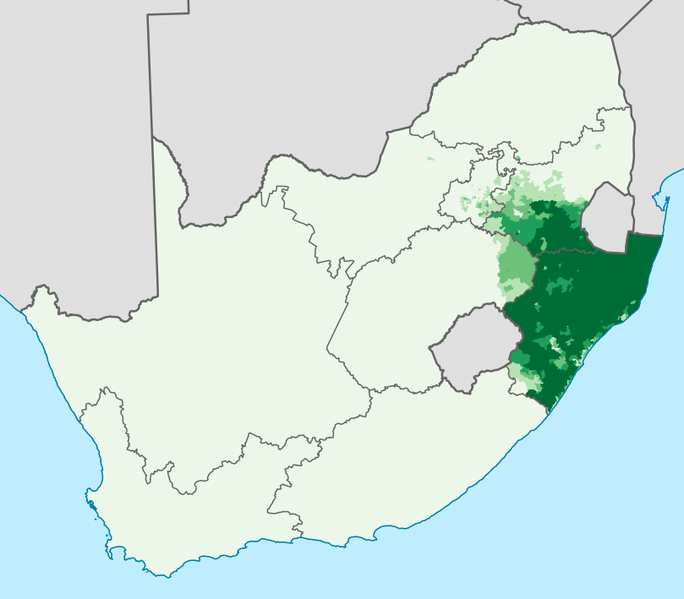
Zulu
Bantu → Southern Bantu → Nguni
One of 11 official languages of South Africa
~11.5M home language speakers as of 2011
Largest home language in South Africa
Understood by 50% of South Africans
Second most widely spoken Bantu language after Swahili
9 174 Wikipedia articles (mostly stubs), 28 active registered users
https://en.wikipedia.org/wiki/Zulu_language, image: https://commons.wikimedia.org/w/index.php?curid=28087429
Notes:
Here are a few orientating facts about Zulu. It belongs to the Nguni group, which is located in the Southern Bantu group, which of course form part of the Bantu language family.
It is one of elevent official languages of South Africa.
In 2011 the national census found that around 11.5M people spoke Zulu as a home language, and it is understood by about half of South Africans.
It is the second most widely spoken Bantu language after Swahili and it has almost 10 000 Wikipedia articles. As I mentioned yesterday, however, most of them seem to consist of single sentences.

Slide 3
Zulu NLP resources
ZulMorph - XFST morphological analyser
WordNet project
NCHLT monolingual corpus - 1.4M sentences
JW300 corpus - 1.1M sentences
Autshumato Eng-Zul parallel corpus - 35k sentences
isizulu.net - not directly an NLP resource, but very useful
Resource grammar WiP¹
https://github.com/LauretteM/gf-rgl-zul
Notes:
Here is a very basic snapshot of resources available for Zulu. It has an XSFT morphological analyser, developed by the other Laurette and Sonja Bosch.
The latter is also currently involved in a WordNet project, aimed at revamping or improving the WordNet already in existence.
The largest curated monolingual corpus I am aware of is the NCHLT corpus, made up mostly of text scraped from government documents.
There are two commonly used English-Zulu parallel corpora - the JW300 corpus containing mostly religious text, and the Autshumato corpus, which is also made up of government website data.
Then, of course, we are now working on a resource grammar. The code is available at the link below. Github does not allow you to make two different forks of the same project. I had already made a fork to work on the Afrikaans, so that I made a new copy to keep the projects separate.

Slide 4
Characteristic features
Agglutinating morphology (conjunctive orthography)
Nominal classification
18 noun classes (depending on how you count)
also called class gender
Concordial agreement of nouns with
verbs, copulatives, relative clauses, adjectives, demonstratives…
uTatjana uzozuza indonda yegolide (Tatjana will win the gold medal)
ya + igolide = yegolide
In GF, this means allomorphs and BIND (&+)
uTatjana u &+ zo &+ zuza indonda ye &+ golide
Notes:
Ass mentioned earlier, the morphology of Zulu is agglutinating and it has a conjunctive orthography. This distinguishes it from related Southern Bantu languages that have a disjunctive orthography, which basically means that verb prefixes tend to be written as separate tokens. In Zulu, however, verb prefixes are written as part of the verb token.
So, depending on how you count, there are 18 different noun classes. This feature is also called class gender by some linguists, and we have found that to be a useful term, as it does indeed behave similar to gender in other languages.
Nouns agree with all sorts of things around them, namely verbs, copulatives, relative clauses, adjectives, demonstratives etc.
Here is a little example to give you a taste. The noun prefix u in uTatjana agrees with the subject concord prefix u in uzuze. The possessive concord in front of the noun igolide is ya, which agrees with indondo. Here we also have an example of morpheme fusion -> ya and i become ye.
The verbs, for example, can take on hundreds of forms, which, if you implement the morphology in the traditional way, causes the compiled grammar to contain thousands of strings that it is unlikely to use during runtime. The grammar becomes unmanageable with even a tiny toy lexicon. The way around this, at least for now, maybe, is to treat the morphology as syntax. You let the compiler create all the pieces of string you’ll need, as though these were the tokens in your grammar, and then you insert the BIND token to let the runtime know to stick them together. In this example, we treat ya and ye as allomorphs of each other - basically different versions of the same morpheme. We also do this with igolide and golide. When they encounter each other, you use some parameters to figure out which versions to stick together to create morphologically sound tokens.

Slide 5
Noun classes
Class | Typical nouns | Prefixes | Subject concords | Object concords
1-2 | persons | umu- / ab(a)- | u, w, ka, e, a, wu / ba, b, be | m, mu / ba, b
1a-2a | proper names, titles | u- / o-
3-4 | nature | umu- / imi- | u, w, wu / i, y, yi | wu, w / yi, y
5-6 | anatomy, birds, fruits, loan words... | i(li)- / ama- | li, l / a, , wa, e | li, l / wa, w
7-8 | anatomy, attitudes, collectives... | isi- / izi- | si, s / zi, z | si, s / zi, z
9-10 (-6) | animals, anatomy, tools... | iN- / isiN- | i, y, yi / zi, z | yi, y / zi, z
11 (-10) | misc, diminutive significance | u(lu)-, lw- | lu, lw | lu, lw, l
14 | abstract | ubu-, u- | bu, b | bu, b
15 | infinitives | uku-, uk-, ukw- | ku, kw | ku, k
16, 17, 18 | locatives | ku- / [pha-, mu-] | ku, kw | ku, k
Notes:
Okay, so here are the 18 noun classes. I don’t know why they skipped the names of 12 and 13 (maybe Laurette knows).
Most nouns belong to two classes, one for singular and one for plural, so the classes can be paired in this way. 1-2, 3-4, 5-6, etc. However, some nouns belong to, for instance, class 9 in the singular and class 6 in the plural.
Then, there are some semantic themes that can be identified in the classes. Class 1 and 2 are always people, and Class 1a and 2a contain names and titles of people.
Each class is associated with its prefix, and this prefix identifies the class the noun belongs to. Then, just to give some idea of how the concordial agreement with verbs work, I’ve added the subject and object concords. Predicates always contain a subject concord, while the use of the object concord is a bit more fluid. Both the subject and object concord can stand in for noun phrases, so you can basically have prodrop on both the subject and object.
The last row contains the so-called locative classes. We’ll get back to this later, but for now it’s worth saying that only class 17 has an associated concords and functions more typically like a noun. The other locatives are more adverbial in nature.

Slide 6
Noun classes
Class | Prefixes | -ntu |  | -Zulu/zulu
1-2 | umu- / ab(a)- | umuntu, abantu | person, people | umZulu, abaZulu | Zulu person, people
1a-2a | u- / o- |  |  | uZulu, oZulu | Mr Zulu, Mr Zulu and co
3-4 | umu- / imi-
5-6 | i(li)- / ama- |  |  | izulu, amazulu | sky, heavens
7-8 | isi- / izi- | isintu | mankind | isiZulu | Zulu language/culture
9-10 (-6) | iN- / isiN-
11 (-10) | u(lu)-, lw-
14 | ubu-, u- | ubuntu | humanity
15 | uku-, uk-, ukw-
16, 17, 18 | ku- / [pha-, mu-] |  |  | phezulu | above
Notes:
Here are just some examples to show how meaning is somewhat associated with the different noun classes. It’s not extremely common, but some noun stems appear in more than two classes.
Discuss.

Slide 7
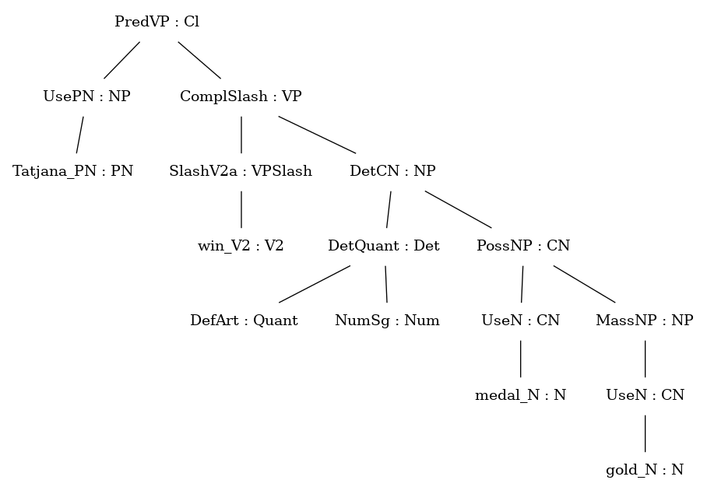
Basic morphosyntax of Zulu
Present | Positive | uTatjana uzuza indondo yegolide
Recent past | Positive | uTatjana uzuze indondo yegolide
Remote past | Positive | uTatjana wazuza indondo yegolide
Remote past | Negative | uTatjana akazuzanga indondo yegolide
Immediate future | Positive | uTatjana uzozuza indondo yegolide
Immediate future | Negative | uTatjana akazuzuza indondo yegolide
O | subject concord, class 1a
O | tense prefix
O | negative prefix
O | root + terminative suffix
O | possessive concord, class 9 (class 5)
Notes:
Here we have an example of a clause rendered in the basic tenses, in the principle indicative mood, with some variation in the polarity. I’ve added some colours to show where morphemes have been bound together at runtime.
Green is the subject concord in each case. Note that it changes in two spots. In the remote past, the underlying form is still u, but it undergoes a phonological change in the presence of the past tense prefix a. In the negative, it changes entirely to ka. For our purposes, we treat all three versions as allomorphs.
Red is the tense prefix - it can be a in the remote past and zo or zu in the immediate future, depending on polarity. It’s a slight remnant of the miniature resource grammar that we haven’t implemented the remote future yet, but unless I’m mistaken, the tense prefix would then be yo or yu.
The negative prefix a can be seen in the two negative sentences, and note that in the remote past, you have to use a different suffix, namely anga, and there is no explicit tense prefix a.
Okay, so that should give you a taste of how Zulu works.

Slide 8
Status in August
Current challenges
If wrong, how wrong?
Ambiguity, overgeneration, compiling
Future challenges
Multilingual lexicon/GF WordNet
Chunk-like parsing

Slide 9
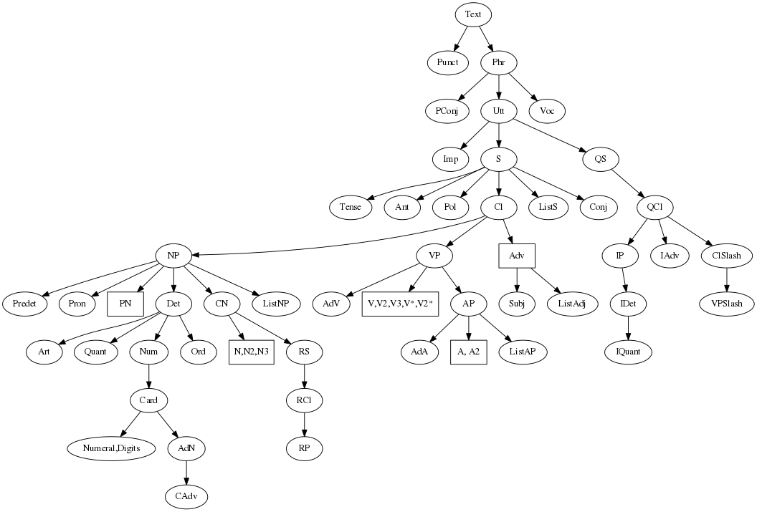
Tour of the Zulu RG
Notes:
I grabbed this from the GF website. Unless I’m mistaken, it’s a bit outdated, but it still does a decent job of giving an overview of the different categories in the resource grammar abstract syntax.

Slide 10
Noun phrases
Notes:
In August I reported on our progress on the noun phrase, and I’ll be spending quite some time giving an update on that. The reason for our focus on the noun phrase is because, syntactically, the noun phrase is the most complex category in Zulu.

Slide 11
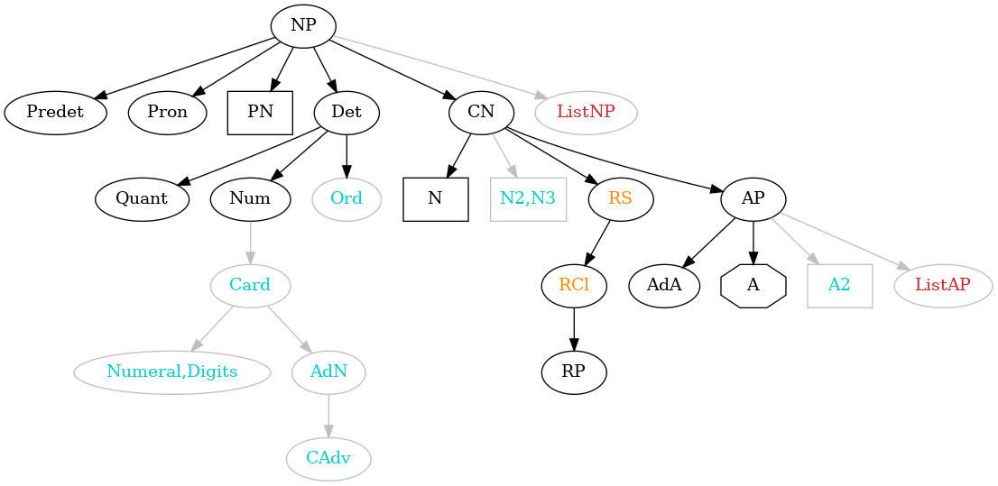
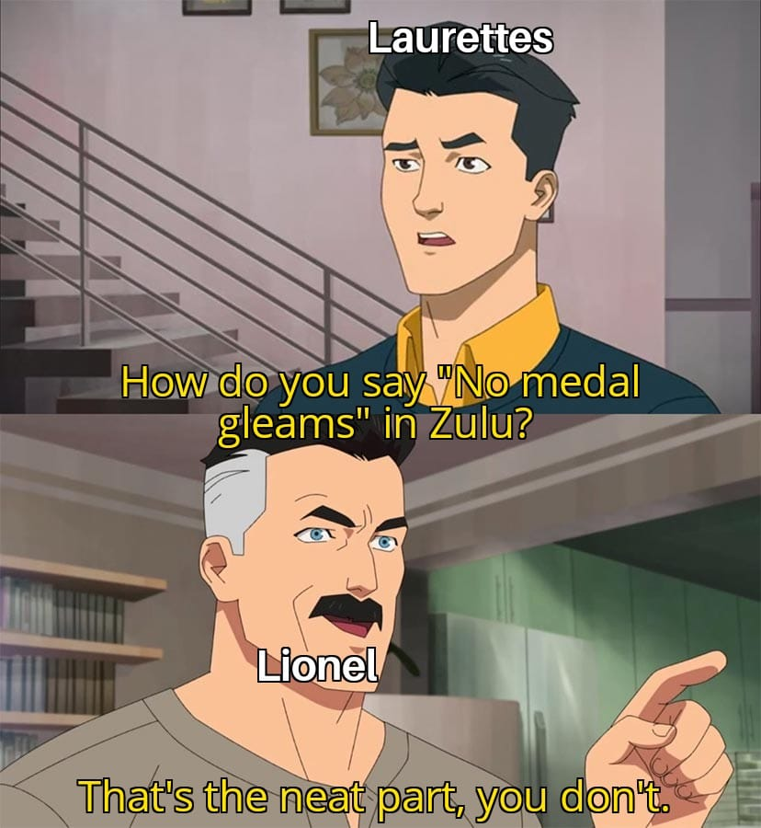
Noun phrase (August 2021)
Black - mature-ish
Orange - under development
Cyan - on ice
Red - not yet implemented
Notes:
In August, we said that we were taking a few liberties with the RG abstract syntax. I am here to report that this has only gotten worse!
There are three main reasons for this
The Zulu grammar has a tendency to blow up - we need to keep it compileable at all times, so we are only implementing things we are reasonably sure about.
Zulu linguistics has never been studied with such a strong focus on “fitting in” with a kind of universal conception of grammar, so we’re doing a lot of figuring out as we go. Sorting out form and function is a lot of two steps forward, at least one step back.
This also means that we can’t optimise too early, because backtracking becomes very difficult. We try to make the code as self-documenting and reflective of the linguistics as far as possible.
Our goal is to produce something useful, and it has to be useful primarily for speakers of Zulu. It has to, therefore, be a recogniseable implementation of Zulu, but we also want to participate in the multilingual advantages of the RGL.

Slide 12
Refactoring the noun phrase
I saw all those big stadiums
ngibone zonke lezi zinkundla ezinkulu
I went to all those big stadiums
ngiye ?
I went to the stadiums
ngiye ezinkundleni
I went to all those big stadiums
ngiye ezinkundleni lezi zonke ezinkulu
ngiye kuzo zonke lezi zinkundla ezinkulu
I went to them all those big stadiums
all those big stadiums
izinkundla lezi zonke ezinkulu
them, all those big stadiums
zona zonke lezi zinkundla ezinkulu
Notes:
This was on top of the to-do list in August of last year. Consider the noun phrase that means “all those big stadiums”. In the first sentence, its use is relatively straight forward. The verb is transitive (or V2) and there’s nothing strange about it.
Consider the second verb “ya”, to go. We can think of the verb as intransitive and make an adverb from the noun “izinkundla” by using its locative form. Now, we can rearrange the pieces of the original noun phrase to modify “ezinkundleni”. Unfortunately, this is not acceptable Zulu! The correct way of expressing the meaning is by using the pronoun associated with the noun, followed by the rest of the noun phrase. This is a kind of apposition or emphasis that the common abstract syntax doesn’t provide, so our only option was to add the necessary functions.

Slide 13
Refactoring the noun phrase?
Function | English example | Zulu translation | Construction
all_Predet : Predet | all day / all the houses | usuku lonke / lonke usuku zonke izindlu / izindlu zonke | inclusive quantitative pronoun
most_Predet : Predet | most people | iningi labantu | genitive (a-lot of people)
only_Predet : Predet | only the man | indoda yodwa / *yodwa indoda | exclusive quantitative pronoun
not_Predet : Predet | not the man | -
Notes:
The problem with only adding functions is that the overgeneration of the grammar very soon gets entirely out of hand. It becomes almost impossible to debug, essentially because it becomes impossible to figure out which tree is supposed to be the right one. Very soon, parsing means almost nothing, and to be honest, the trees themselves mean almost nothing.
So, let me give you some idea of how we went to work. Very soon after recruiting Lionel to our cause, we started a table analysing the common abstract syntax, especially with regards to the noun phrase.
We listed all functions in the common abstract syntax, along with the English examples in the comments, where available. Then, we asked Lionel to help us essentially to translate the English so that we could understand what each function would have to do in Zulu. These are the predeterminer functions.
…
This was not difficult to deal with: we would just not implement most_Predet and not_Predet.

Slide 14
Refactoring the noun phrase?
Function | English example | Zulu translation | Construction
every_Det : Det | every (man) | leyo naleyo ndoda | conjunction of demonstratives
few_Det : Det | few people | abantu abambalwa | copulative , primitive relative stem
many_Det : Det | many people | abantu abaningi | copulative, noun
much_Det : Det | much time | isikhathi esiningi | copulative, noun
someSg_Det : Det | some person | umuntu omunye | copulative, enumerative stem
somePl_Det : Det | some people | abantu abanye | copulative, enumerative stem
Notes:
The functions for directly construction determiners was more of a challenge, since almost all the meanings are expressed using relative copulatives, aside from “every”, which uses a kind if reduplication of the demonstrative pronoun to say, in effect, “that and that man”. The other functions for constructing determiners compositionally were not much better, since the concept itself doesn’t really work the same way the common abstract syntax has it. In the end, we realised that the concept of a determiner as defined by the common abstract syntax, just doesn’t exist in Zulu. In its place, however, there are other things.
And so, we basically started from scratch, figuring out which categories are necessary and how they combine, and only afterwards checking to see which parts of what we came up with have equivalents in the common abstract syntax.

Slide 15
Noun phrase functions
DetCN | : Det -> CN -> NP
UsePN | : PN -> NP
UsePron | : Pron -> NP
RelNP | : NP -> RS -> NP
NumSg, NumPl | : Num
UseN | : N -> CN
PossNP | : CN -> NP -> CN
IndefArt, DefArt | : Quant
MassNP | : CN -> NP
PossPron | : Pron -> Quant
AdjCN | : AP -> CN -> CN
RelCN | : CN -> RS -> CN
AdvCN | : CN -> Adv -> CN
PartNP | : CN -> NP -> CN
Notes:
Here are two lists: one showing the functions from Noun.gf that were implemented, and one showing some of the more prominent functions that we did not implement. Most surprising, perhaps, is adjective modification.
Zulu modification has essentially only two strategies: possessives and relatives. The former: indonda yegolide (medal of gold) and the latter: indonda enkulu (the medal that is big)
In fact, “big medal” and “medal that is big” is one and the same construction, which is why AdjCN is superfluous.
But why did we leave out RelCN then? This has to do with the order in which possessive modification and relative modification happens in Zulu. Of course, in English you have the phenomenon where “the big green tree” is preferred over “the green big tree”. Zulu is similar in this regard, but the rule for the placement of possessives and relatives seems to be more strict. In order to enforce this, we only allow RelNP.

Slide 16
Extra noun phrase categories functions
cat
 | NP
 | CN
 | N
 | Quant
 | Num
 | Predet
 | Pron
cat
 | Postdet
 | QuantStem
 | Loc
 | LocN
Notes:
In our refactoring process, we retained almost all the noun phrase related categories (although we skipped the more esoteric ones, like two- and three-place nouns).
We added some categories, most notably Postdet and QuantStem. Originally we had only Predet, and letting functions place it either in front of or behind the noun, but even this was too overgenerating, because there are different word order rules for predeterminers and postdeterminers. The had to create two different quantifier-like categories. We have let the Quant category represent Zulu demonstratives (this, that, and yonder), while the QuantStem now represents the two quantitative pronouns “all” and “only”, and they can be used to construct predeterminers, but they are not equivalent to predeterminers.

Slide 17
Nouns
Params
ClassGender | C1_2 | C1a_2a | C3_4 | C5_6 | C7_8 | C9_10 | C11_10 | C9_6 | C14 | C15 | C17
NForm | Full | Reduced | Poss | Loc
Agr | First Number | Second Number | Third ClassGender Number
Number | Sg | Pl
kundla_N (stadium)
s | Sg | Pl
Full | inkundla | izinkundla
Reduced | nkundla | zinkundla
Poss | nkundla | zinkundla
Loc | enkundleni | ezinkundleni
c | C9_10
Lincat of N
s | Number => NForm => Str
c | ClassGender
Lincat of CN
s | Number => NForm => Str
mod | Number => Str
c | ClassGender
?
Notes:
This slide shows the implementation of the noun and common noun lincats in a nutshell.
First, we look at the relevant parameters. You can see that we’ve paired the noun classes where relevant, so that any given noun stem (or, more accurately noun stem sense) is associated with only one class gender value.
Then, we have four forms of the noun stem that function somewhat like allomorphs. The full form includes the prefix, the reduced form drops any leading vowel. The possessive form for nouns is the same as the reduced form, but the parameter is retained all the way up to the noun phrase level, so it is used for pronouns as well, where the possessive form is different. Finally, we have the default locative form, which in most cases is the stem with an e prefix and an ini suffix. We have a bunch of nice paradigms that sort out the phonological changes that can happen here.
Our agreement parameter uses person as a constructor, and includes class gender in the third person.
Of course, we get the Number parameter from the ParamX module.
N is still the same, but CN has changed. At the time of the summer school, we had two string based fields, because it was necessary to insert strings between the base string and the modifier. This is actually something that the refactoring fixed! Since we excluded the possibility of adding possessive modifiers after already having relative modifiers in the abstract syntax, we didn’t need to enforce this in the concrete syntax by allowing insertions between to strings.

Slide 18
Nouns
Params
ClassGender | C1_2 | C1a_2a | C3_4 | C5_6 | C7_8 | C9_10 | C11_10 | C9_6 | C14 | C15 | C17
NForm | Full | Reduced | Poss | Loc
Agr | First Number | Second Number | Third ClassGender Number
Number | Sg | Pl
khundla_N (stadium)
s | Sg | Pl
Full | inkundla | izinkundla
Reduced | nkundla | zinkundla
Poss | nkundla | zinkundla
Loc | enkundleni | ezinkundleni
c | C9_10
Lincat of N
s | Number => NForm => Str
c | ClassGender
Lincat of CN
s | Number => NForm => Str
c | ClassGender
emph | Bool
Prefix morphology
Notes:
We now only have one string based field, and we’ve added a boolean to keep track of whether the CN is emphasised, so that we can deal correctly with the prefix morphology later on.

Slide 19
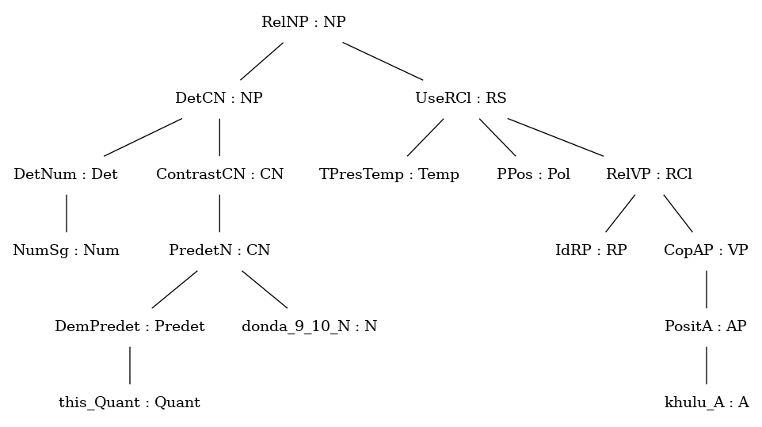
Nouns
indondo
le ndondo
yona le ndondo
le ndondo yona
le ndondo enkulu
le ndondo yona enkulu
medal
this medal
this very medal
this medal, on the other hand
this big medal
this big medal, on the other hand
Notes:
These examples illustrate another issue that has been resolved.
In Zulu, using the pronoun associated with a noun can indicate emphasis or contrast depending on where it is placed. The final example shows it being used to indicate contrast, and as you can see, it appears between the noun indondo and its modifier enkulu.

Slide 20
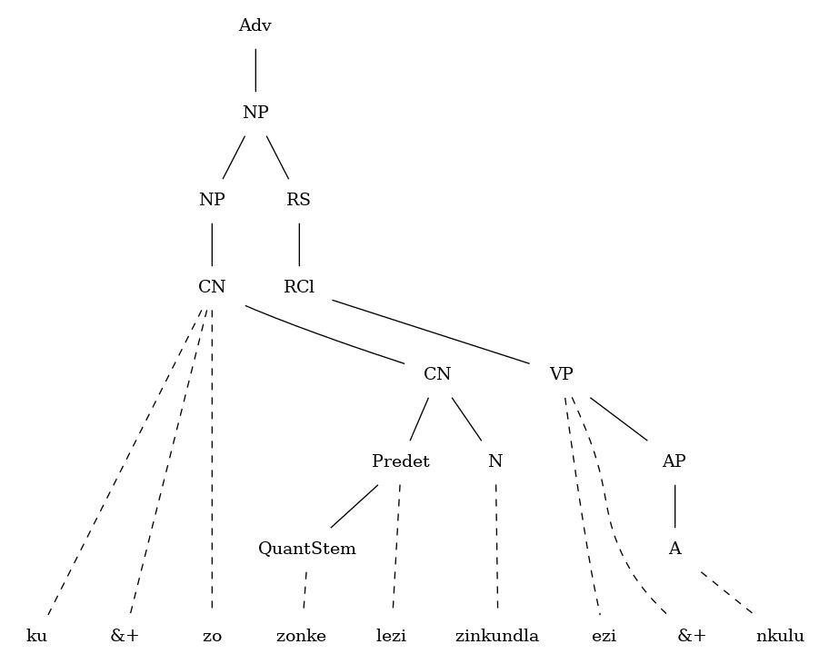
Nouns
ngiye kuzo zonke lezi zinkundla ezinkulu
EmphCN
Notes:
These examples illustrate another issue that has been resolved.
In Zulu, using the pronoun associated with a noun can indicate emphasis or contrast depending on where it is placed. The final example shows it being used to indicate contrast, and as you can see, it appears between the noun indondo and its modifier enkulu.
I should mention that the grammar currently expects a different form of the past tense “ngiye”, but we have an idea for fixing it that would fit in quite well with the refactored categories and functions.

Slide 21
Noun phrases in GF
Lincat of NP
s | NForm => Str
mod | Str
predet_pre | Str
predet_post | Str
agr | Agr
qdef | QuantDef
proDrop | Bool
isPron | Bool
ngiyabona le ndondo
angiboni le ndondo
I see this medal
I don’t see this medal
word order tbd
ngiyabona indondo
angiboni indondo
angiboni ndondo
I see a/the medal
I don’t see the medal
I don’t see a medal
?
Lincat of VP
... | ...
comp | Polarity => Str
Notes:
Word order tbd - that is actually a sign that things are going south

Slide 22
Noun phrases in GF
Lincat of NP
s | NForm => Str
mod | Str
predet_pre | Str
predet_post | Str
agr | Agr
qdef | QuantDef
proDrop | Bool
isPron | Bool
Lincat of NP
s | NForm => Str
agr | Agr
i | RInit
proDrop | Bool
isPron | Bool
heavy | Bool
Notes:
Much better!

Slide 23
Roundup
Zulu code has been merged into gf-rgl
Dedicated folders for extending the grammar and compiling with different lexica
Lexica:
DevLex (very small, for testing)
MultiLex (+- 1000 entries, English function names)
MonoLex (almost 17k entries, Zulu function names)
Chunking
New module PChunk.gf
Challenges
retrieving the most useful parse (tinkering with probabilities)
especially in the case of low quality data
Regression treebanks (soon) at github.com/LauretteM/gf-zulu-resources
Next
Auxiliary verbs
V3, VS

